Slide 1
Retail churn prediction
Anand Umrani
Kyatham Nikhil

Slide 2
Introduction
A small to medium-scale organization that majorly deals in wine, fruits and meat products, having held around 35% market share.
Organization wants to stay competitive. Challenges are to compete with quickly expanding companies.
RetailKart.com goes Online and sets the roadmap to Customer Acquisition and Increase the Transactions on the platform.
One such Project is to offer Personalized Experience for its Customer Shopping Experience.

Slide 3

Primary goals
Perform EdA on the data
Generate Model to predict the churn

Slide 4
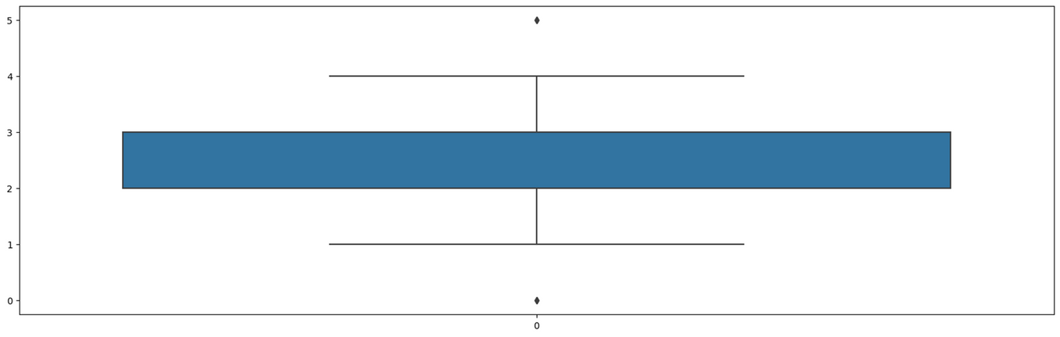
Exploratory Data Analysis
Outlier Analysis: Hours spent on App (1 Outlier)

Slide 5
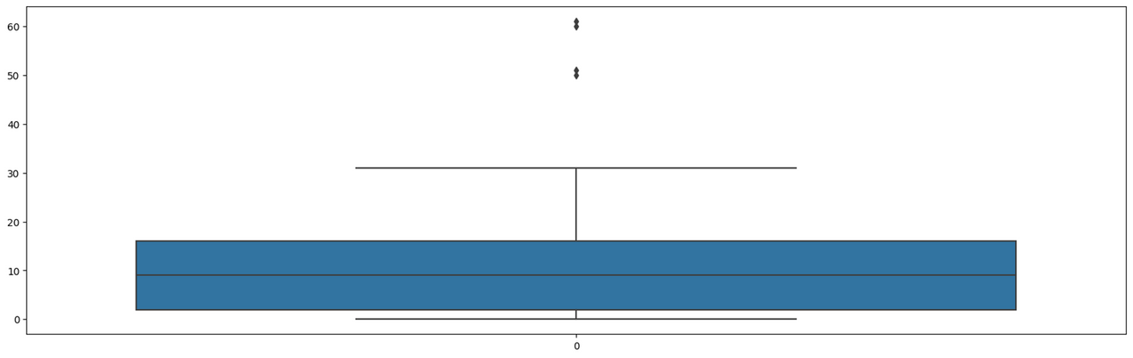
Exploratory Data Analysis
Outlier Analysis: Tenure (4 Outliers)

Slide 6

Exploratory Data Analysis
Outlier Analysis: Number of Addresses (3 Outliers)

Slide 7
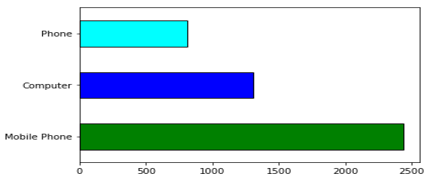
Exploratory Data Analysis
Most of the Users are using Mobile phone as platform for placing orders

Slide 8
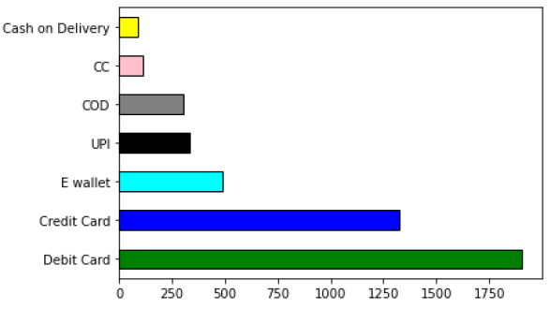
Exploratory Data Analysis
The debit card transaction is the highest payment mode in the entire population.

Slide 9
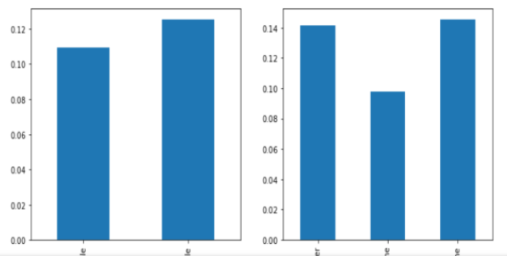
Exploratory Data Analysis
Males have higher chances of churn rate than that of females.
People who are calling via phone and placing orders have a higher churn rate.

Slide 10
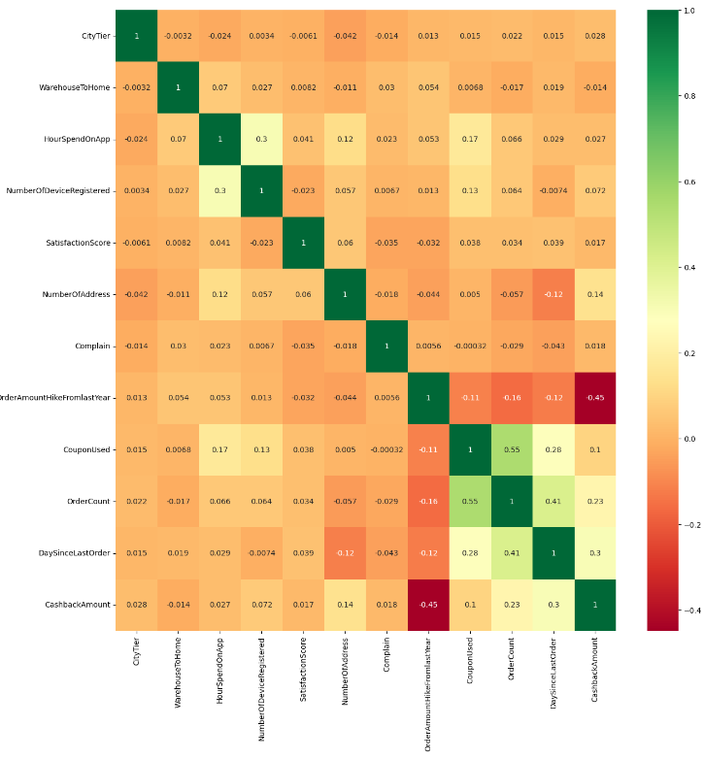
Exploratory Data Analysis
There are multiple attributes which show a high degree of multi collinearity.

Slide 11
Model Outcomes
Used Logistic Regression model. The results are as below:
Generalized Linear Model Regression Results
Dep. Variable: | Churn | No. Observations: | 5616
Model: | GLM | Df Residuals: | 5585
Model Family: | Binomial | Df Model: | 30
Link Function: | Logit | Scale: | 1.0000
Method: | IRLS | Log-Likelihood: | -1714.5
Date: | Sun, 30 Jul 2023 | Deviance: | 3429.0
Time: | 05:07:30 | Pearson chi2: | 6.10e+03
No. Iterations: | 8 | Pseudo R-squ. (CS): | 0.5396
Covariance Type: | nonrobust

Slide 12
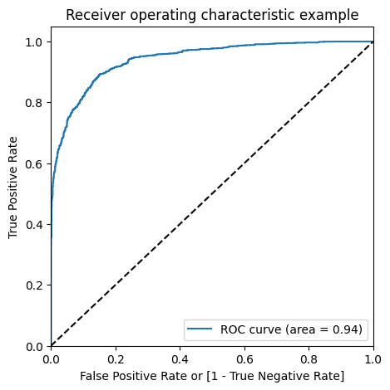
Model Outcomes
ROC Curve:

Slide 13
Model Outcomes
Model Accuracy: 0.8354059985369422
Confusion Matrix: array([[1035, 170], [ 55, 107]])
Sensitivity: 0.6604938271604939
Specificity: 0.8589211618257261
F1 score: 0.4874715261958998
The Overall Model Accuracy is 83% which is an indication that this model is able to predict the churn in the dataset.

Slide 14

Thank you

